Slide 1

Customer Shopping Behavior Analysis
Uncovering insights from 3,900 purchases to guide strategic business decisions.

Slide 2

Project Overview & Goals
1
2
Analyze Behavior
Segment Customers
Examine customer spending patterns and product preferences.
Identify distinct customer groups and their subscription behavior.
3
Guide Decisions
Provide actionable insights for strategic business planning.

Slide 3
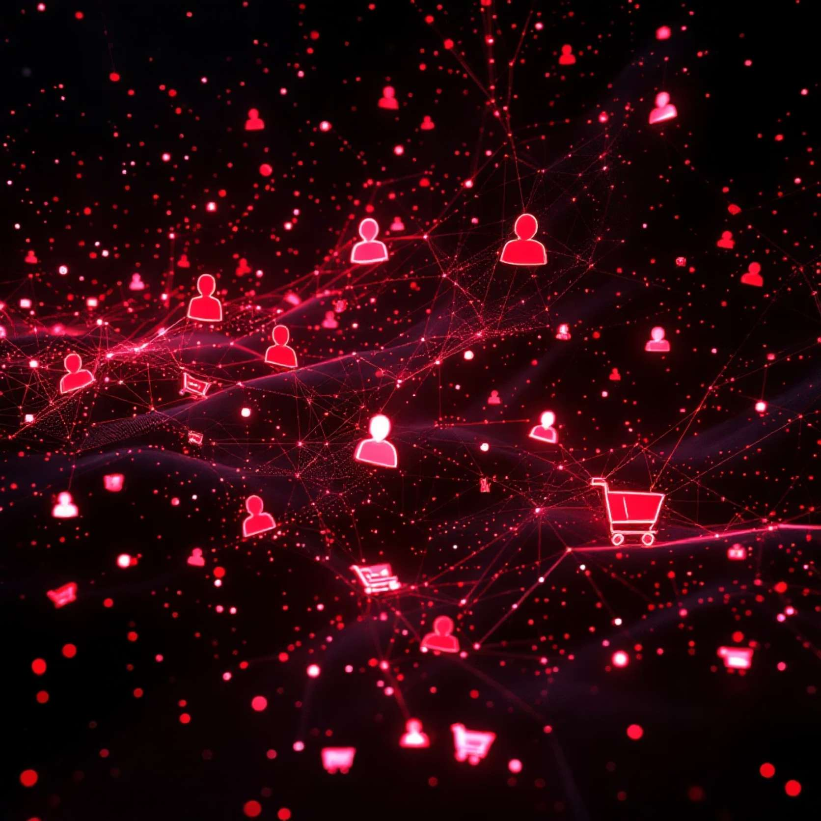
Dataset Summary
Our analysis is based on transactional data from 3,900 purchases, featuring 18 key columns:
Customer demographics (Age, Gender, Location, Subscription Status)
Purchase details (Item, Category, Amount, Season, Size, Color)
Shopping behavior (Discount, Promo Code, Previous Purchases, Frequency, Review, Shipping)
Only 37 missing values in 'Review Rating' were imputed.

Slide 4

Exploratory Data Analysis (Python)
01
Data Preparation
Loaded dataset, checked structure, and summary statistics.
02
Missing Data Handling
Imputed 'Review Rating' using median per product category.
03
Feature Engineering
Created age groups and purchase frequency columns.
04
Database Integration
Loaded cleaned data into PostgreSQL for SQL analysis.

Slide 5

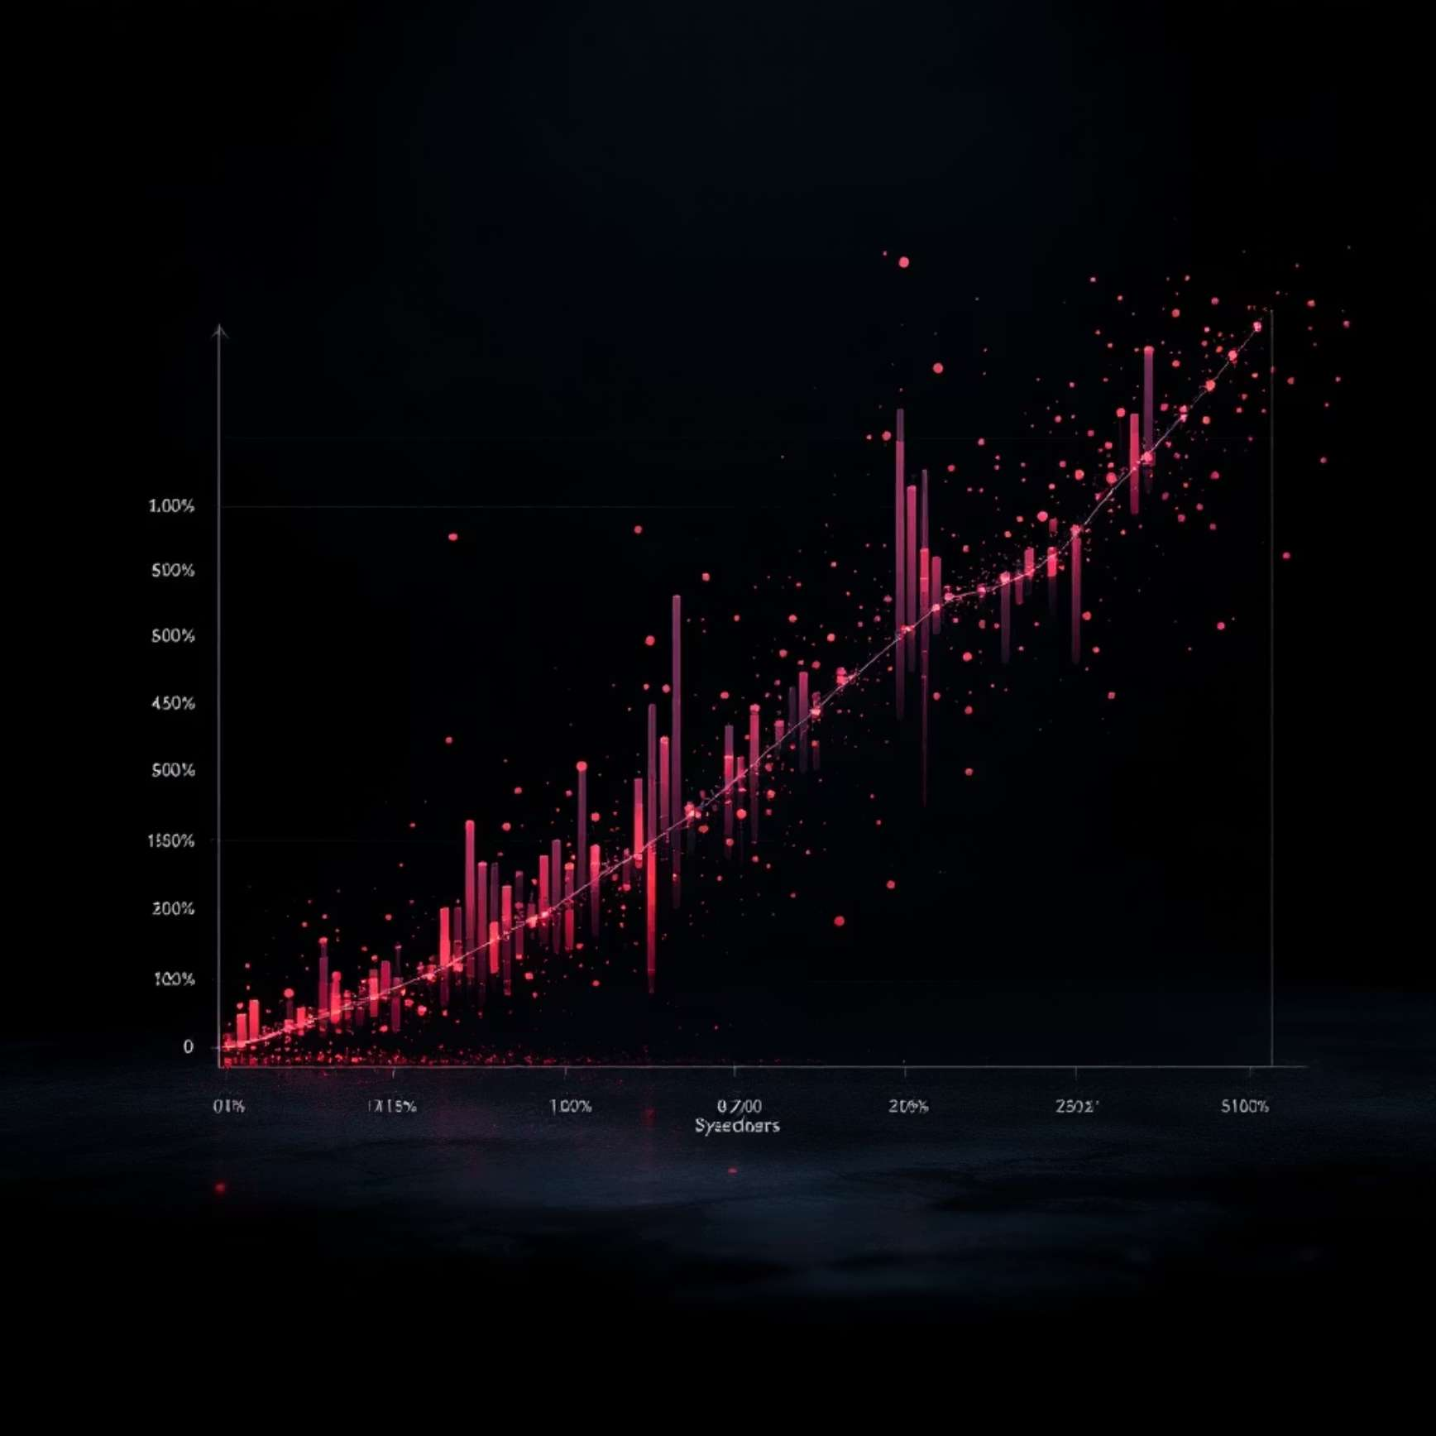
SQL Analysis: Revenue & Discounts
Revenue by Gender
High-Spending Discount Users
Compared total revenue generated by male vs. female customers.
Identified customers using discounts but spending above average.
This analysis helps understand the impact of discounts on different customer segments.

Slide 6
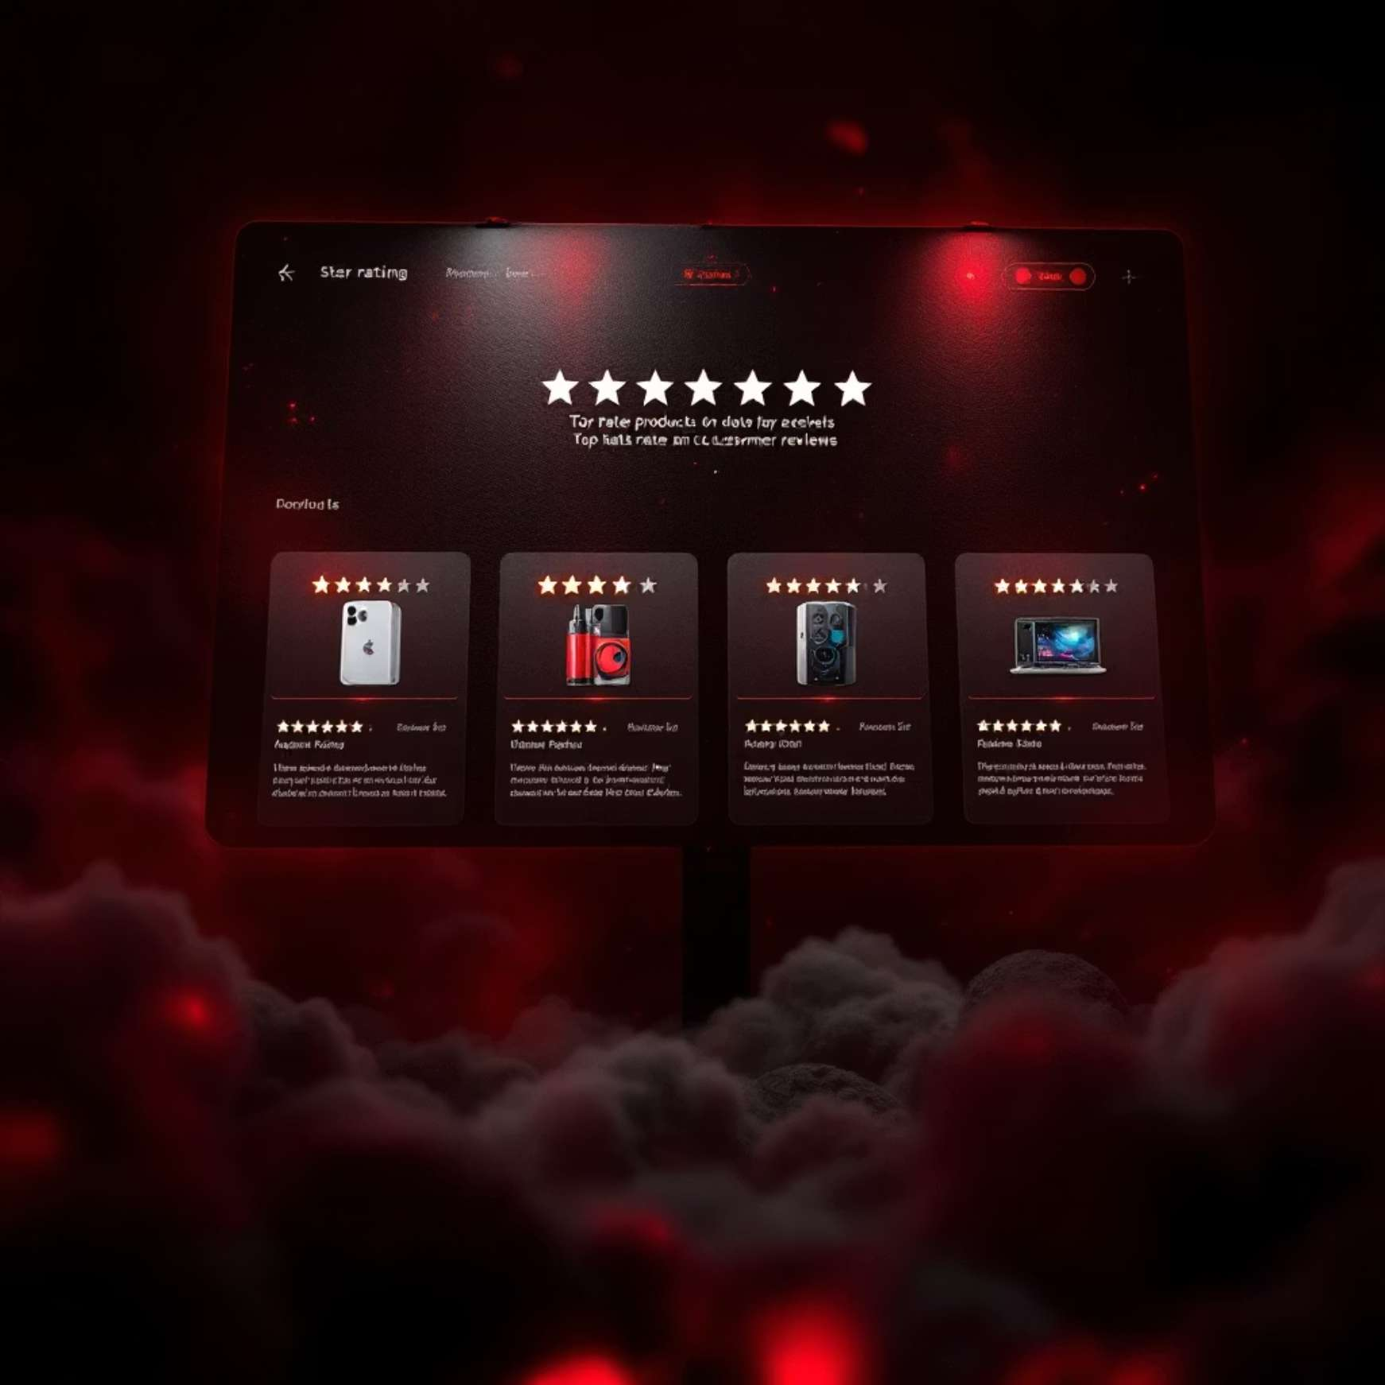

SQL Analysis: Product & Shipping
Top 5 Products by Rating
Shipping Type Comparison
Found products with the highest average review ratings.
Compared average purchase amounts between Standard and Express shipping.
Insights into product quality and shipping preferences can optimize operations.

Slide 7


SQL Analysis: Subscription & Loyalty
Subscribers vs. Non-Subscribers
Discount-Dependent Products
Compared average spend and total revenue across subscription statuses.
Identified products with the highest percentage of discounted purchases.
Understanding subscription impact and discount effectiveness is crucial for growth.

Slide 8




SQL Analysis: Customer Segmentation
Returning Customers
Multiple purchases.
New Customers
First-time buyers.
Loyal Customers
Frequent, high-value purchases.
This segmentation helps tailor marketing strategies for each group.

Slide 9
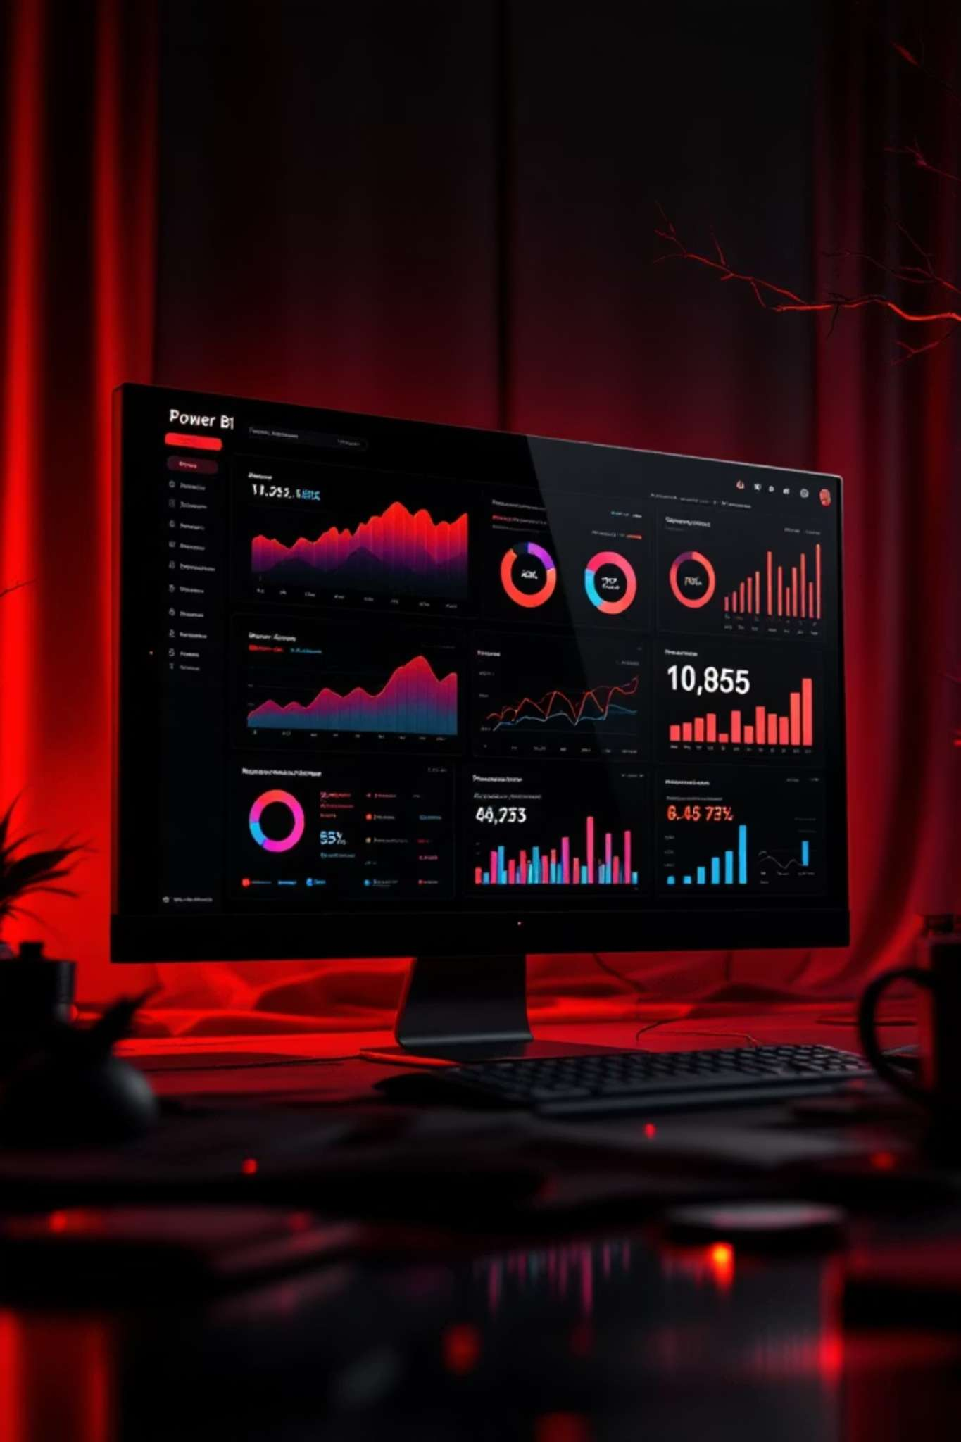
Dashboard in Power BI
An interactive Power BI dashboard was built to visualize key insights.
This dashboard provides a dynamic view of customer behavior, enabling real-time decision-making.

Slide 10

Business Recommendations
Boost Subscriptions
Promote exclusive benefits for subscribers.
Customer Loyalty
Reward repeat buyers to foster loyalty.
Review Discount Policy
Balance sales boosts with margin control.
Targeted Marketing
Focus efforts on high-revenue age groups and express-shipping users.

